Slide 1
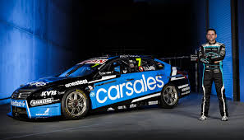
Exploratory data analysis of “Car Sales”

Slide 2
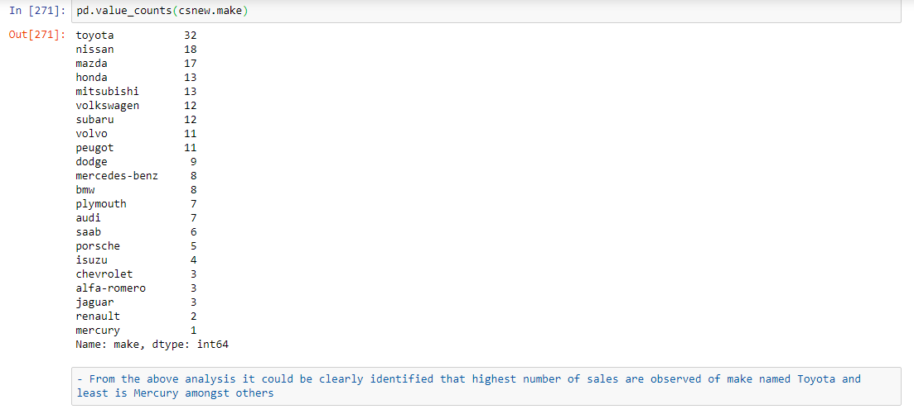
Which make of cars are highest in sales?

Slide 3
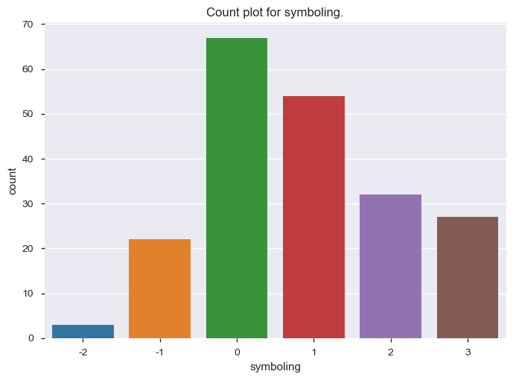
Which symboling of vehicles are mostly sold?
Observation: From the above plot it could be identified that most of the vehicles sold are moderately risky.

Slide 4
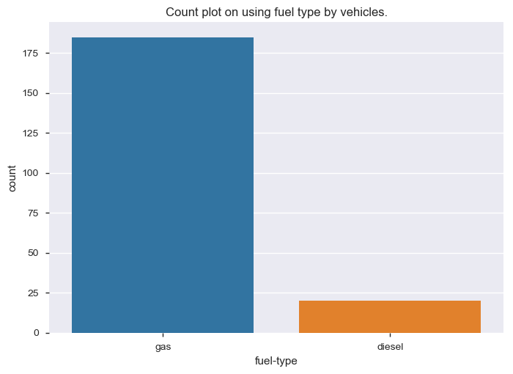
Which kind of fuel-type of cars are sold most and least?
Observation: It is observed that most of the vehicles sold are fuel-type that run on Gas and least sold are Diesel.

Slide 5
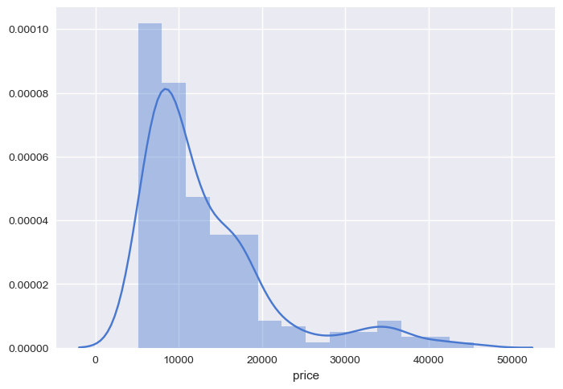
What are prices of most the vehicles fall in between?
Observation: It is inferred that most of the vehicles are priced in between mid-10000 and mid-20000.

Slide 6
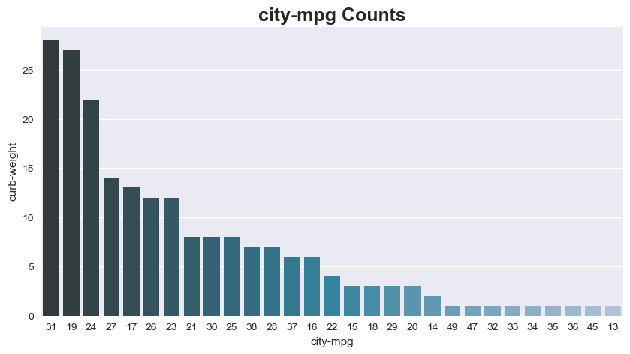
What is the curb-weight that is high with a high city-mpg in sales?
Observation: 31 as City-mpg vehicles are mostly a curb-weight of 25 being high in sales

Slide 7
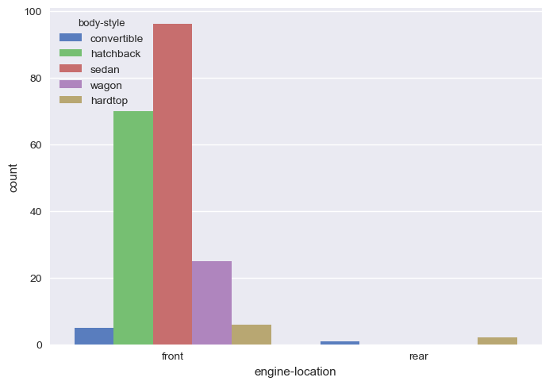
Which kind of engine-location is mostly present in various body-styles that are sold?
Observation: From the plot it is understood that most of the vehicle sales are sedan and hatchback that have front engine location.
Vehicles with rear engine location are low in sales and are found in convertible and hardtop body-style.

Slide 8
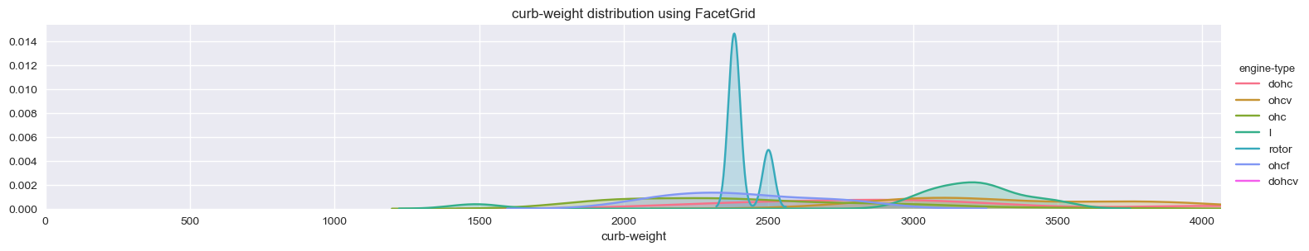
Identify sales of which type of engines are seen mostly with highest curb-weight cars?
Observation: L engine type is highest in curb weight being 2250-2600 are mostly sold

Slide 9
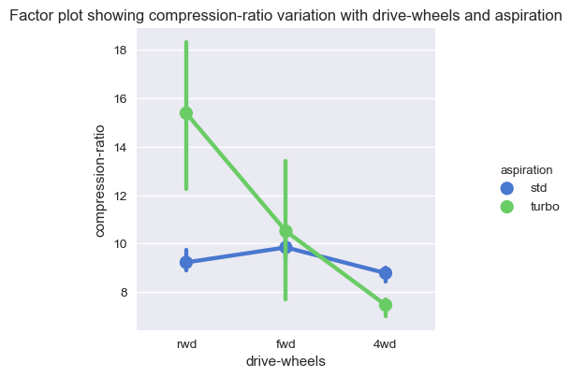
Which aspiration is high in sales with significance to compression-ratio?
Observation: Rear wheel driver vehicles have high compression-ratio which are of turbo aspiration that are highly sold.
vehicles with aspiration of std are low in compression-ratio in all kinds of wheel drivers hence sold less.

Slide 10
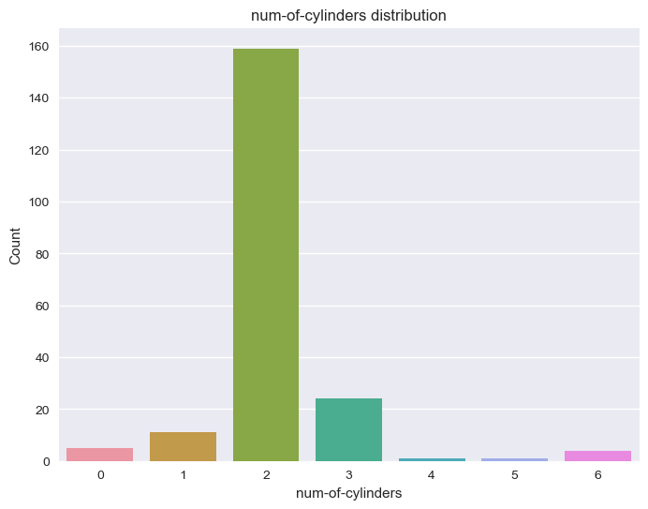
What is the distribution of num-of-cylinders that are in cars and sold highly?
Observation: Most of the vehicles sold are having 2 num-of-cylinders.

Slide 11
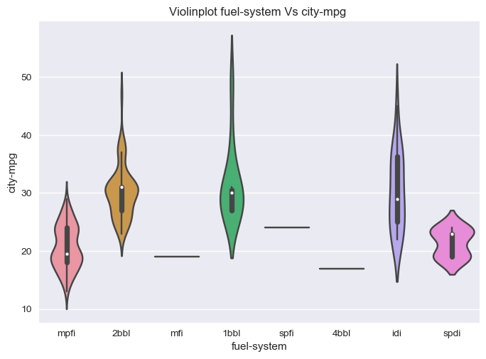
Which of the fuel-systems has higher city-mpg that are sold mostly embedded in cars?
Observation: idi kind of fuel-system is more consistent in city-mpg hence sold more that is between 20-40 mpg
Least is mpfi fuel-system whose city-mpg ranges between 15-25 mpg are less sold.

Slide 12
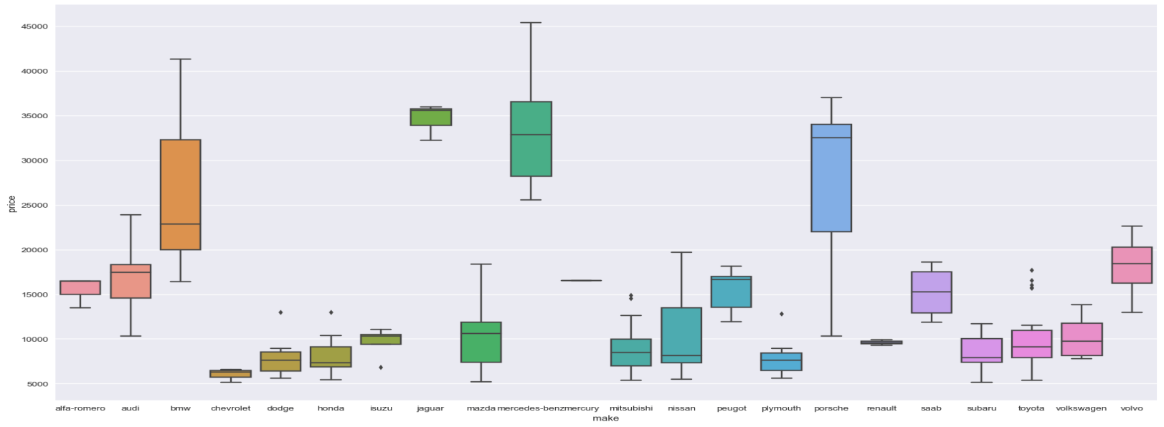
Which make of vehicles are highly sold depending on high and low price?
Observation: From the Boxplot it is found that highest prices are 20000-35000 found among Mercedes-benz, Jaguar, Porsche and BMW which are the luxury vehicles.
Vehicles such as Alfa-romero, Audi, Peugot, Saab, Volvo are also luxury vehicles but are priced between 10000-20000.
There are vehicles that are priced between 5000-15000 such as Chevrolet, Dodge, Honda, Isuzu, Mazda, Mitsubishi, nissan, plymouth, renault, sabaru, toyota and volkswagon which are observed to be mostly sold in large amounts units

Slide 13
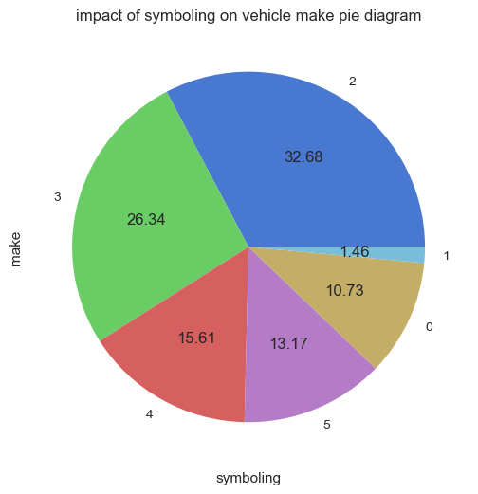
What is the percentage of make that has less rating of symboling which increases sales?
Observation: from the above pie-chart it is inferred that 1.46+10.73=12.19% of the vehicle make have less symboling hence sold more.

